Slide 1
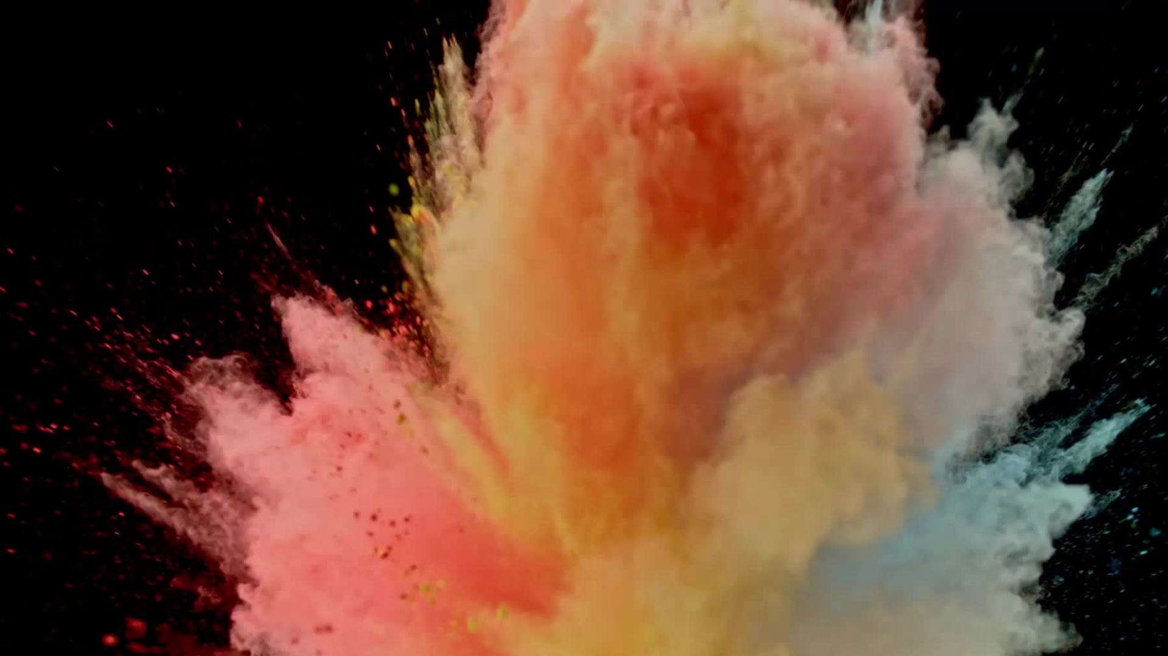
Diagnosis ML
Chris Burley, Brandon Lee, Vik Shah, Navid Motlagh, Tu Cam Dang

Slide 2
Agenda
Project Background & Objective – Tu Cam
Project Scoping – Navid
Extract Transform Load & Cleaning Data – Vik
Machine Learning Modelling – Chris
Machine Learning Predictions – Brandon

Slide 3
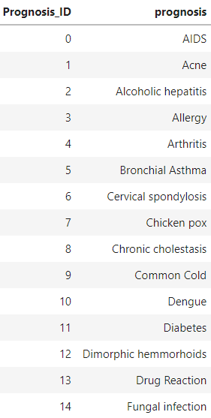
Background
Using a survey form, patients can input symptoms and machine learning will be used to provide a prognosis

Slide 4
Scoping
Identified sample dataset from Kaggle, listing 132 variables/ symptoms

Slide 5
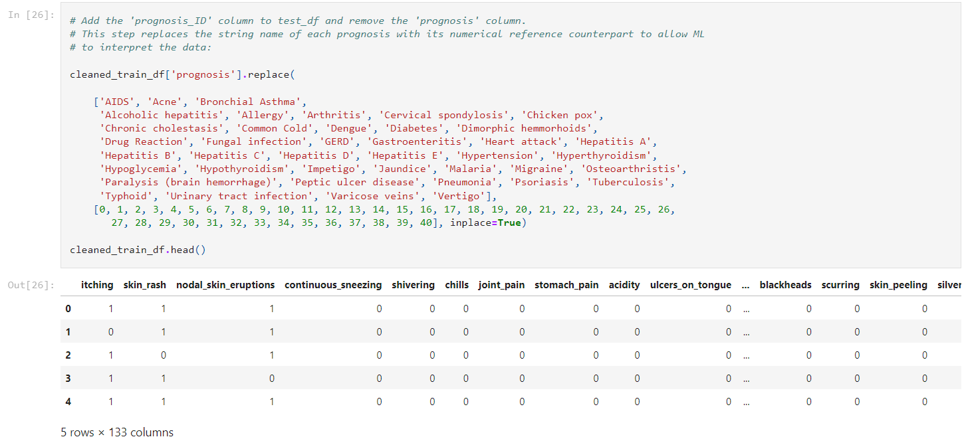
Extract Transform Load
Extract from kaggle,
Import csv
Transform dataset,
Delete blank column
Rename columns to simply and normalize
Replace similar data to uniform
Delete null rows
Load dataframe,
Cleaned_train_df

Slide 6
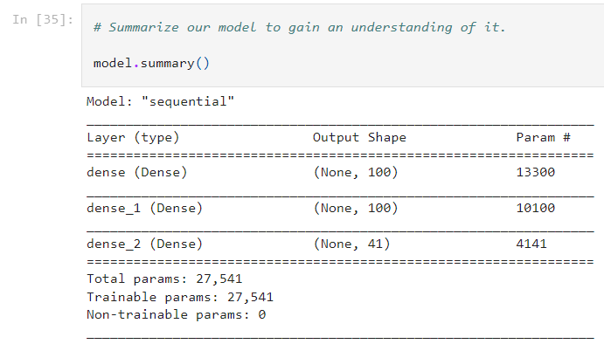
Modelling

Slide 7
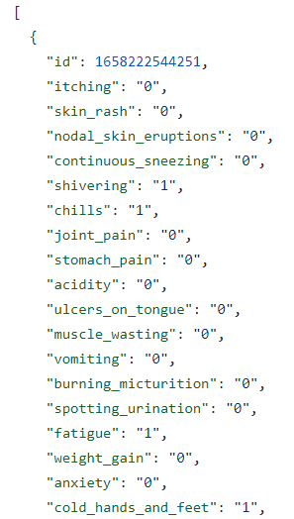
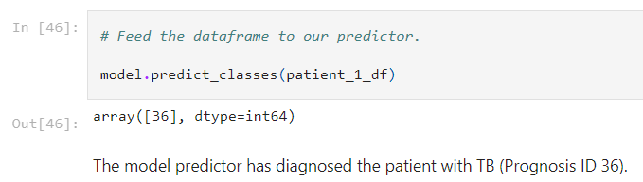

Predictions
Patient/ Doctor inputs symptoms in form and ML predicts prognosis

Slide 8
Questions
What happens at bootcamp stays at bootcamp

